Slide 1
POETRY REFLECTIONS
Rhythm & Rhyme

Slide 2
RHYTHM
Rhythm is based on repetition.
Poetic rhythmic patterns can be organized as meter or free verse.

Slide 3
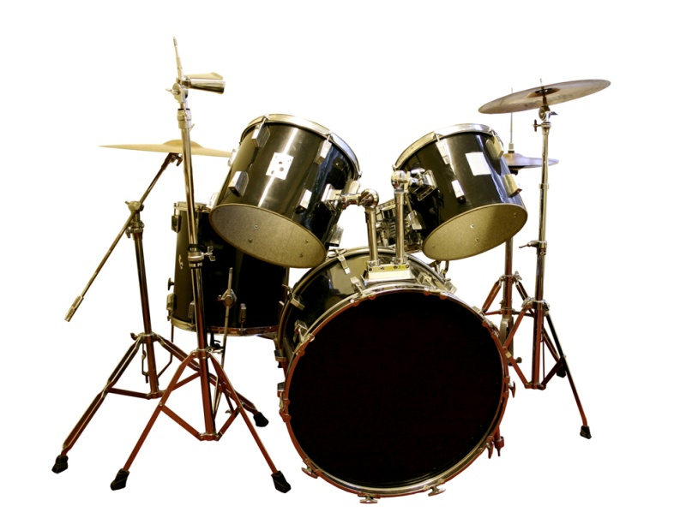
RHYTHM
Poetry that is written in meter has a regular pattern of stressed and unstressed syllables in each line. This pattern sets the beat of the poem.
Scanning a poem is analyzing the rhythm of the poem.

Slide 4
RHYTHM
A foot is usually one stressed syllable and one or more unstressed syllables.
An iamb is an unstressed syllable followed by a stressed syllable (da DAH).
Iambic pentameter is a type of rhythmic pattern. It is made up of 5 iambs -- 5 feet of unstressed-stressed syllables (da-DAH, da-DAH, da-DAH, da-DAH, da-DAH)

Slide 5
RHYTHM
Free verse is poetry that is free of any strict pattern of stressed-unstressed syllables. It has no specific rhythm or rhyme.

Slide 6
RHYME
A rhyme scheme is a regular pattern of rhyming words at the end of each line in a poem. A sequence of letters is used to indicate rhyme scheme. For example, if every other line in each stanza rhymes, the rhyme scheme is abab.
Roses are red, (red = a)
Violets are blue, (blue = b)
Whatever is in your head, (head = a)
Should make a better person of you. (you = b)

Slide 7
I Wandered Lonely as a Cloud
William Wordsworth

Slide 8
I Wandered Lonely as a Cloud –
William Wordsworth
I wandered lonely as a cloud
That floats on high o'er vales and hills,
When all at once I saw a crowd,
A host, of golden daffodils;
Beside the lake, beneath the trees,
Fluttering and dancing in the breeze.

Slide 9
Continuous as the stars that shine
And twinkle on the milky way,
They stretched in never-ending line
Along the margin of a bay:
Ten thousand saw I at a glance,
Tossing their heads in sprightly dance.
The waves beside them danced; but they
Out-did the sparkling waves in glee:
A poet could not but be gay,
In such a jocund company:
I gazed—and gazed—but little thought
What wealth the show to me had brought:
For oft, when on my couch I lie
In vacant or in pensive mood,
They flash upon that inward eye
Which is the bliss of solitude;
And then my heart with pleasure fills,
And dances with the daffodils.

Slide 10
For oft, when on my couch I lie
In vacant or in pensive mood,
They flash upon that inward eye
Which is the bliss of solitude;
And then my heart with pleasure fills,
And dances with the daffodils.

Slide 11
I Wandered Lonely as a Cloud
Looking back on a moment when he was inspired by the beauty of nature, Wordsworth evokes a scene of golden daffodils lining a bay in the Lake District of England. That glimpse of loveliness eased his loneliness at the time, and gives him pleasure each time he remembers it.

Slide 12
I Wandered Lonely as a Cloud
1. As the speaker wandered, he was in a _______________ state of mind.
a. joyful
b. lonely
c. calm
2. Why might the speaker compare himself to a cloud?
a. To the speaker, clouds seem cold and unfeeling.
b. To the speaker, clouds symbolize pure joy and peacefulness.
c. Like the speaker, a cloud is by itself and distant from the world.

Slide 13
I Wandered Lonely as a Cloud
3. To what does the speaker compare the host of daffodils?
a. Clouds
b. Stars
c. Poets
4. Where are the daffodils located?
a. Beside a lake
b. On a mountain

Slide 14
I Wandered Lonely as a Cloud
5. What effect does the sight of the daffodils seem to have on the speaker as he views the scene?
a. Knowing that the flowers will not last, he feels frustration.
b. He is no longer lonely and troubled, but joyful.
6. What is the rhyme scheme of the following passage?
“I wandered lonely as a cloud/That floats on high o’er vales and hills,/When all at once I saw a crowd,/A host, of golden daffodils.”
a. aabb
b. abab

Slide 15
I Wandered Lonely as a Cloud
7 What does the poet do to set off the final two lines in each stanza?
a. He adds images of sight.
b. He has the final words in each line rhyme.
c. He has the final words in each line rhyme with other words in the stanza.
8. What is the wealth the speaker believes the daffodils have brought to him?
a. The ability to find strength and happiness in the beauty of nature
b. The ability to write about nature and then sell his writing for money

Slide 16
I Wandered Lonely as a Cloud
9. How does rhyme scheme reinforce meaning in the following passage?
“They flash upon that inward eye/Which is the bliss of solitude;/And then my heart with pleasure fills,/And dances with the daffodils.”
a. The rhyme scheme makes the entire passage musical.
b. The final two lines, which contain the main idea of the piece, stand out because they have their own rhyme.
c. The poet rhymes the final four lines with the rest of the poem.

Slide 17
Uphill
Christina Rossetti

Slide 18
Uphill
Christina Rosetti
Does the road wind up-hill all the way?
Yes, to the very end.
Will the day’s journey take the whole long day?
From morn to night, my friend.
But is there for the night a resting-place?
A roof for when the slow dark hours begin.
May not the darkness hide it from my face?
You cannot miss that inn.

Slide 19
Shall I meet other wayfarers at night?
Those who have gone before.
Then must I knock, or call when just in sight?
They will not keep you standing at that door.
Shall I find comfort, travel-sore and weak?
Of labour you shall find the sum.
Will there be beds for me and all who seek?
Yea, beds for all who come.

Slide 20

Uphill
The poem seems to be a conversation between a traveler seeking directions and a helpful expert. It has serious overtones. The uphill road is life's journey, and the beds at journey's end are graves. The traveler is thus asking about the difficulty of life and whether there is hope for peace in the end.

Slide 21
Uphill
1. The speaker in the poem “Uphill” learns that “the road winds uphill all the way.” What does that mean in the context of the poem?
a. The road is very steep.
b. The task is too difficult to undertake.
c. The traveler must complete the journey alone.
d. The difficulties of life never end.

Slide 22
Uphill
2. In “Uphill,” the bed at the inn is a symbol representing ______________.
a. sleep
b. safety
c. death
d. punishment

Slide 23
Uphill
. How does the questioner, or speaker, in “Uphill” feel about life’s journey?
a. Confused
b. Anxious
c. Resentful

Slide 24
Uphill
4. How does the rhyme pattern in “Uphill” affect the poem’s meaning?
a. The rhyming words are key words that reveal the speaker’s feelings.
b. The pattern of alternating rhymes links the questions and answers.
c. The rhyme pattern creates a tense, suspenseful mood.

Slide 25
Summer
Walter Dean Myers

Slide 26
Summer
Walter Dean Myers
I like hot days, hot days
Sweat is what you got days
Bugs buzzin from cousin to cousin
Juices dripping
Running and ripping
Catch the one you love days
Birds peeping
Old men sleeping
Lazy days, daisies lay
Beaming and dreaming
Of hot days, hot days,
Sweat is what you got days.

Slide 27
Summer
In this picture of summer, the literal meaning of the poet's words are as important as the rhymes and strong, irregular rhythm.

Slide 28
1. The purpose of dividing “Summer” into two separate stanzas is to
a. contrast levels of activity.
b. create conflicting moods.
c. minimize the poem’s musical quality.
d. convey a factual impression of summer.

Slide 29
2. The speaker in “Summer” ______________ the season.
a. dreads
b. enjoys
c. respects
d. tolerates

Slide 30
Sonnet 30
William Shakespeare

Slide 31
Sonnet 30
William Shakespeare
When to the sessions of sweet silent thought
I summon up remembrance of things past,
I sigh the lack of many a thing I sought,
And with old woes new wail my dear time's waste:
Then can I drown an eye, unus'd to flow,
For precious friends hid in death's dateless night,
And weep afresh love's long since cancell'd woe,
And moan the expense of many a vanish'd sight:

Slide 32
Then can I grieve at grievances foregone,
And heavily from woe to woe tell o'er
The sad account of fore-bemoaned moan,
Which I new pay as if not paid before.
But if the while I think on thee, dear friend,
All losses are restor'd and sorrows end

Slide 33
Sonnet 30
Shakespeare writes of regret and sorrow and the way in which the thought of a friend eases both.

Slide 34
Sonnet 30
1. In Sonnet 30 what is the cause of the speaker’s unhappiness?
a. The pain of love
b. His financial losses
c. His memories of past sorrows
d. The absence of a dear friend

Slide 35
Sonnet 30
2. The final lines of Sonnet 30—”But if the while I think on thee, dear friend,/All losses are restored and sorrows end”—are an example of a ______________.
a. refrain
b. couplet
c. quatrain

Slide 36

Sonnet 30
3. Which of the following words best describes the mood of the speaker at the end of Sonnet 30?
a. Regretful
b. Sentimental
c. Serene
d. Guilty

Slide 37
Sonnet 30
4. Sonnet 30 is primarily about the
a. comforts of friendship.
b. lessons of experience.
c. difficulties of life

